Slide 1
Chan-Vese Segmentation
Yizhen (Stephen) Jia

Slide 2
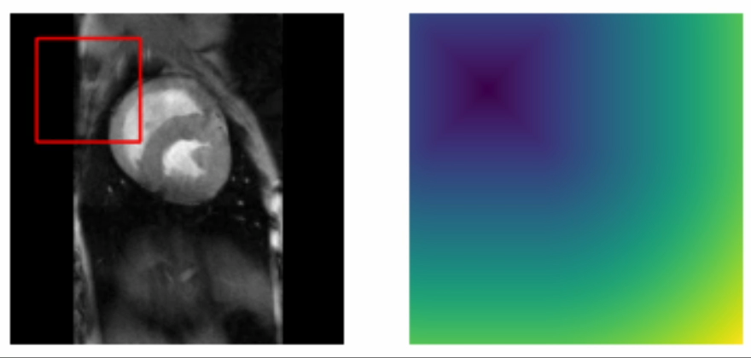
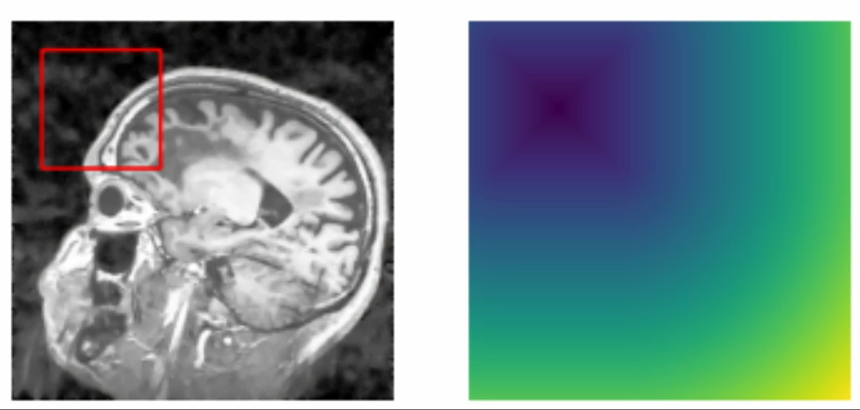
Project Outputs

Slide 3
Introduction and key concepts
Chan-Vese (by Tony F. Chan and Luminita A. Vese in 2001) : an image segmentation algorithm using active contours and level set methods. Paper link: https://www.math.ucla.edu/~lvese/PAPERS/IEEEIP2001.pdf
Region-based technique, focuses on homogeneous regions, not edge detection.
Signed Distance Function (SDF): A function that represents the distance from a point to a curve or surface.
Curvature: A measure of how much a curve deviates from being a straight line, used as a penalty term in the energy functional.
Convergence: A condition to stop iterating when the segmentation result does not change significantly.

Slide 4
Advantages
Robust to noise and weak edges, as it focuses on region homogeneity rather than edge detection.
Handles topological changes automatically due to the level set representation.
Applicable to various imaging modalities, such as MRI, CT, and ultrasound.

Slide 5
Algorithm overview
Convert the input image to grayscale and normalize.
Initialize the level set function (e.g., checkerboard or signed distance function).
Compute the Chan-Vese energy functional for the current level set function.
Evolve the level set function by minimizing the energy functional using gradient descent.
Repeat steps 3 and 4 until convergence or a maximum number of iterations is reached.
Extract the segmented regions from the final level set function.

Slide 6
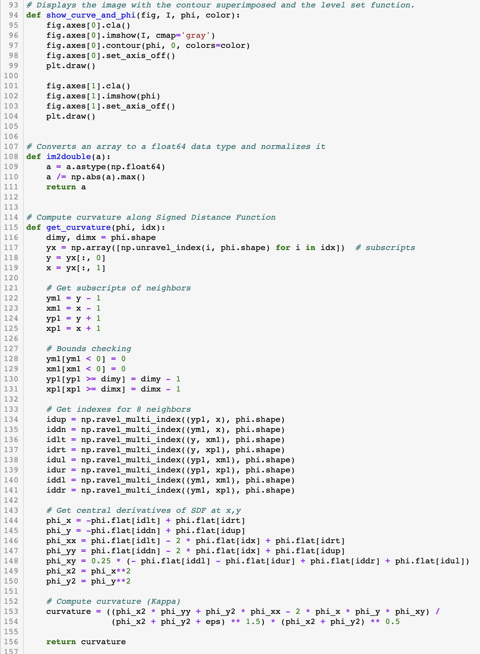
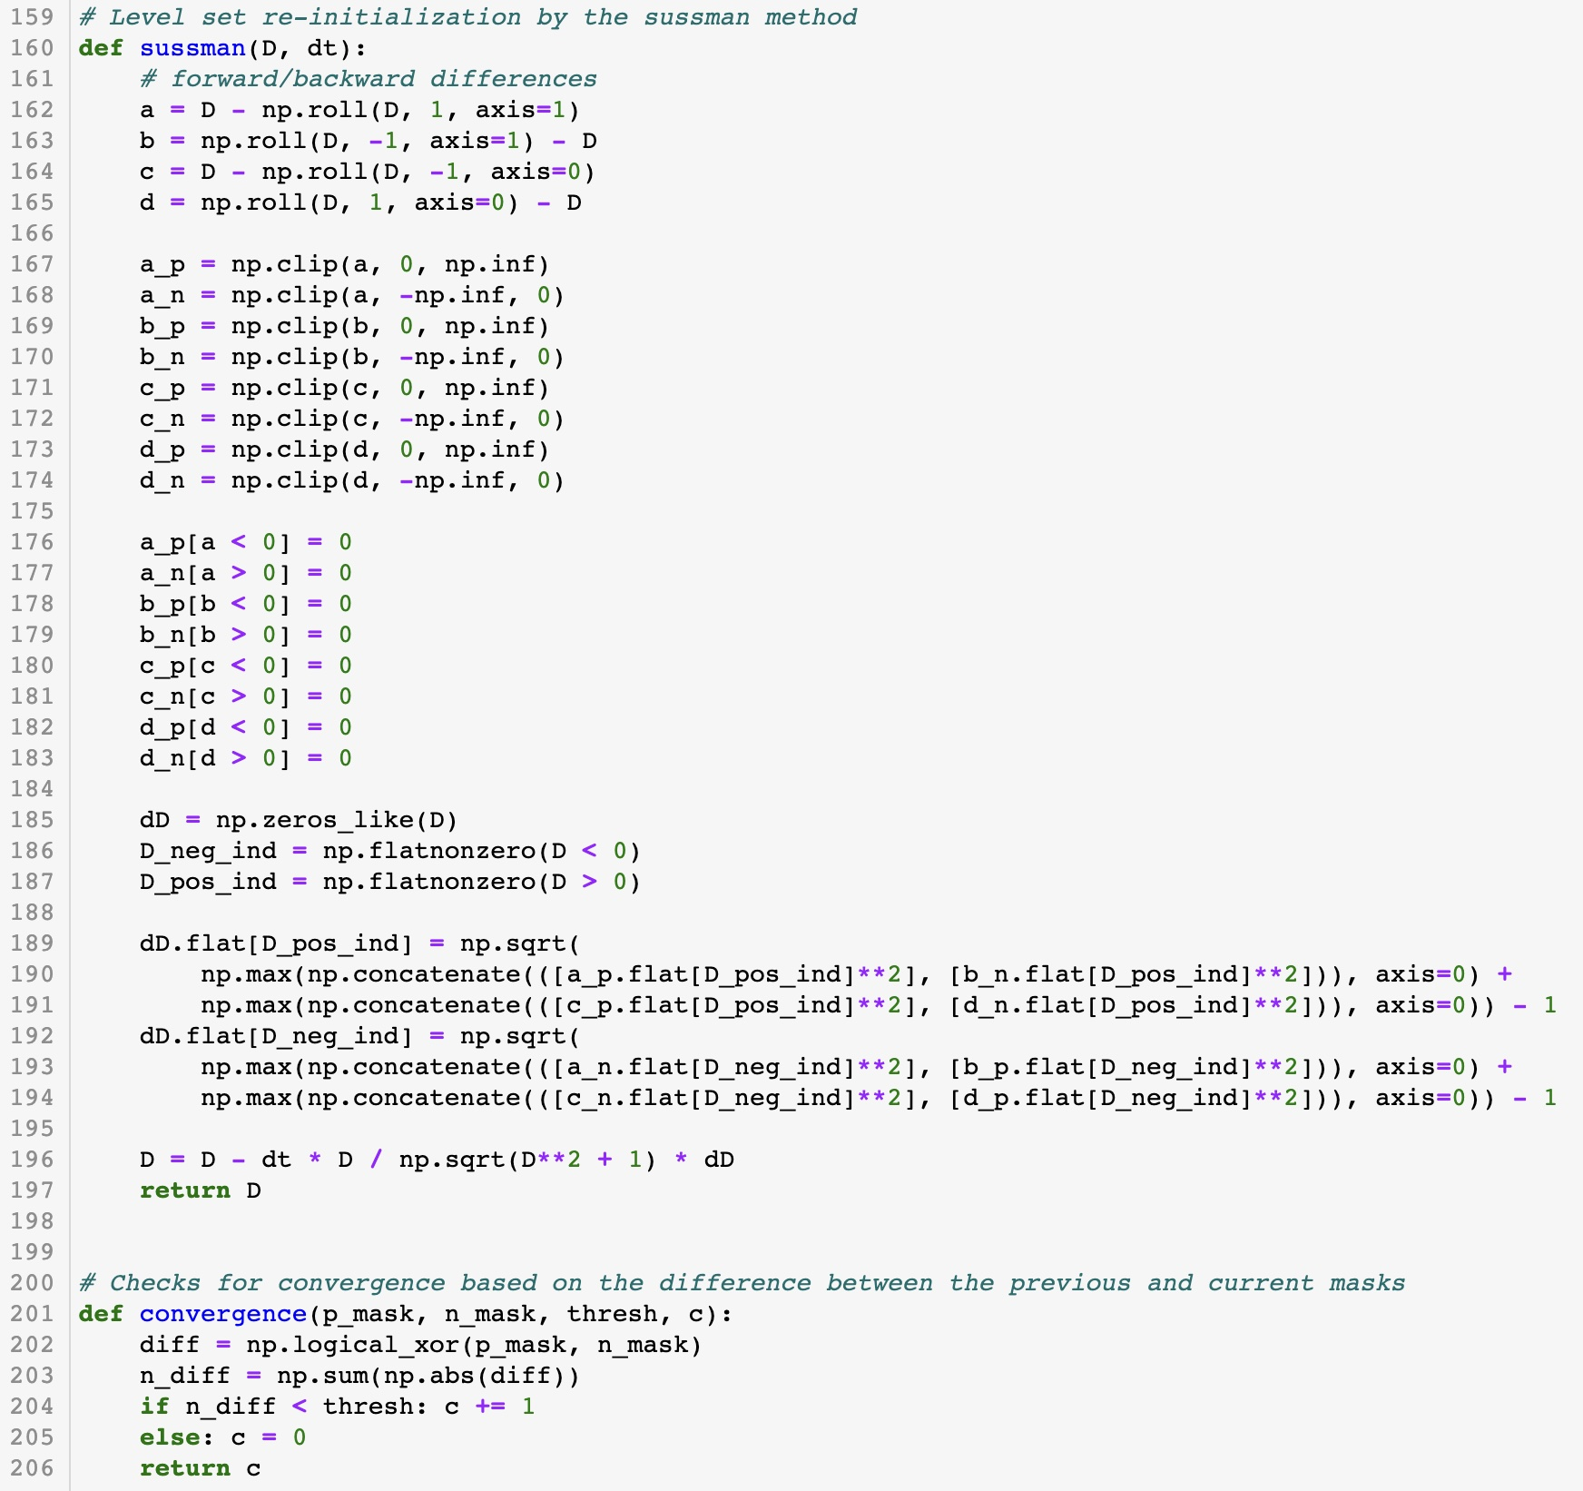
full code

Slide 7
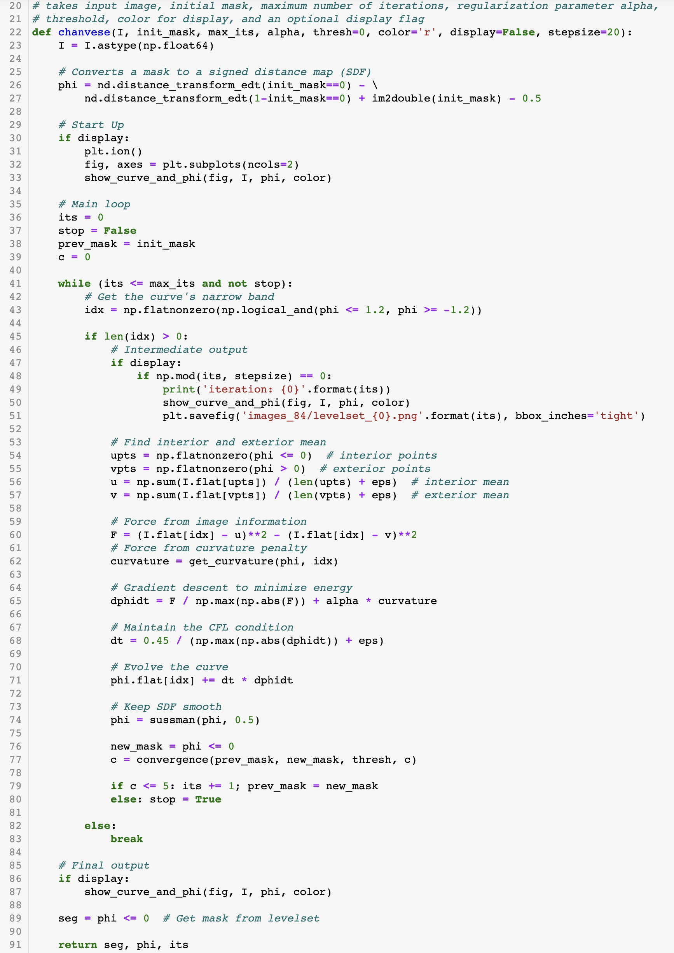
Demonstration
In this code, I demonstrate the implementation of the Chan-Vese segmentation method for image processing.
I use a level-set approach to evolve a contour, enabling the segmentation of objects in images.
The code is structured with the main function ‘chanvese()’, which takes an input image, initial mask, maximum number of iterations, regularization parameter alpha, threshold, color for display, and an optional display flag.
The core of the Chan-Vese algorithm is executed in the main loop,
which I iterate until reaching the maximum iterations or convergence.
I evolve the contour based on image information and curvature penalty.
Signed distance functions are used to maintain smoothness, and I check for convergence periodically.

Slide 8
applications
Medical image segmentation: Tumor detection, organ segmentation, and tissue classification.
Object recognition and tracking in computer vision.
Background subtraction in video analysis.
Texture segmentation in remote sensing and satellite imagery.

Slide 9
conclusion
The Chan-Vese segmentation method provides a powerful, region-based approach to image segmentation.
Its flexibility and robustness make it suitable for various applications, particularly in medical imaging.
Adjusting algorithm parameters can help tailor the method to specific images and segmentation tasks.

Slide 10
Thank you so much for listening
REFERENCES:
Author: Burak Bayramli,
http://ascratchpad.blogspot.com/2011/03/image-segmentation-using-active.html

